Slide 1
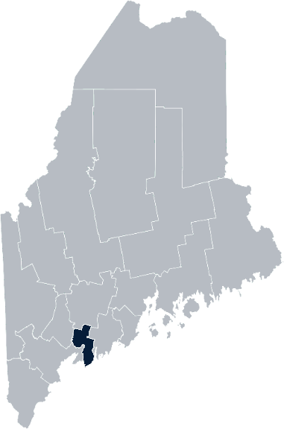
Maine Shared Community Health Needs Assessment Sagadahoc County
2021
Notes:
Welcome – Drexell White

Slide 2
The Maine Shared CHNA is a collaboration between the Maine Center for Disease Control and Prevention (Maine CDC), Central Maine Healthcare, Northern Light Health, MaineGeneral Health, and MaineHealth.
Notes:
Drexell White

Slide 3
Time | Activity | Speaker/Facilitator
12:00 – 12:05 pm | Welcome | Drexell White, Midcoast District Liaison, MeCDC
12:05-12:10 pm | Overview of Zoom, Maine Shared CHNA | Jo Morrissey, Maine Shared CHNA Program Manager
12:10-12:15 pm | Leadership Remarks | Lois Skillings, RN, MS, FACHE, President Mid Coast-Parkview Health, MaineHealth
12:15-12:25 pm | Review previous CHNA priorities and activities 2019-2021 | Drexell White, Midcoast District Liaison, MeCDC Melissa Fochesato, Director, Community Health Promotion
12:25-12:45 pm | Presentation of key findings from the data | John Snow, Inc.
12:45 – 1:35 pm | Break-out session – facilitated discussion on data and health priority identification | Local Facilitators
1:35-1:45 pm | Reconvene and Review | John Snow, Inc.
1:45 – 1:55 pm | Wrap up and next steps | Melissa Fochesato, Director, Community Health Promotion
Notes:
Drexell White

Slide 4
Share screen
Join Audio, Mute On/Off
Open/close participant list or chat
Turn Video On/Off
Reactions
Notes:
Jo or JSI

Slide 5
Matching Interests
Maine Shared
Community Health Needs Assessment
Images of PHAB and IRS from the internet
Notes:
Jo or JSI

Slide 6
The Evolution of an Idea…
2010 OneMaine | 2015 SHNAPP | 2018 Maine Shared CHNA | 2021 Maine Shared CHNA
Forums Surveys | 16 Forums 1639 Surveys | 22 Mainstream Forums (live) 2 Immigrant Forums 45 Interviews | 16+ Mainstream Forums (virtual) 12+ Community Sponsored Events 2000+ Oral Surveys
Notes:
Jo or JSI

Slide 7
Inputs and Outcomes
Ways to Provide Input
Data Collected
Outcomes
District & County Reports DUE APRIL 2022
4 Health Priorities by county
Related indicators
Gaps/barriers and resources/assets
Notable comparisons between attendee input and the data.
Description of those who provided input
Methodology
Mainstream county forums
Number of attendees
Where attendees live (not CSE)
List of data identified Forums and CSE only)
Discussion notes (Forums and CSE only)
Chat box comments (Forums and CSE only)
Health Priorities
Gaps and Resources
Community sponsored events
State Report DUE APRIL 2022
4 Health Priorities by Community Event and immigrant population.
Related indicators
Gaps/barriers and resources/assets,
Notable comparisons to mainstream population.
Description of those who provided input
Methodology
Oral Survey
Forums, Events and Surveys conducted Fall 2021
Notes:
[Add names of those doing the leadership remarks ie Susan Keiler, VP Strategic Development of Southern Maine Health Care
Dr. Patrick Taylor, CEO/President of York Hospital]
Jo or JSI
Community Sponsored Event Partners include
Disability Rights Maine (2 events: people who are deaf or hard of hearing and people with other disabilities)
Maine Primary Care Association (People who are served by Maine’s Federally Qualified Health Centers
Maine Council on Aging (Older Adults 65+
Consumer Right Council of Maine (people with a mental health diagnosis)
Formerly Incarcerated (Maine Prisoner Re-Entry Network)
Maine Youth Action Network and Friends (Raising the voices of Maine’s diverse youth)
Green Memorial A.M.E. Zion Church (Black/African American)
Health Equity Alliance (LGBTQ+ community)
Portland Recovery Center (for people with a substance use disorder or in recovery)
ADD HOUSING INSECURE IF NEED BE
ADD VETERAN IF NEED BE
Oral Survey Partners include:
City of Portland’s Minority Health Program
New Mainer’s Public Health Initiative
Maine Immigrant Access Network
Gateway Community Services
Maine Immigrant and Refugee Services
Maine Community Integration
Mano en Mano
We are piloting these additional outreach methods with support from
State of Maine’s Preventative Health and Health Services Block Grant
Maine Health Access Foundation
Introduce leader for leadership remarks

Slide 8
Leadership remarks
Notes:
Leadership remarks
Leader to introduce the following who will provide comments on recent health improvement efforts
ADD NAME OF THOSE WHO WILL BE DOING REVIEWING PREVIOUS EFFORTS
Lois Skillings, President/CEO, Mid Coast Hospital
Drexell White, District Liaison ME CDC - Efforts
Melissa Fochesato, Director, Community Health Promotion, Efforts

Slide 9
Previous Health Improvement Efforts Sagadahoc County: Highlights 2019-2021
Notes:
Jo to introduce Drexell White, Public Health Liaison, Midcoast Public Health District
Melissa Fochesato, CHA Community Health Improvement
who will provide comments on recent health improvement efforts

Slide 10
Pandemic Acknowledgement and Thanks
During this past CHNA cycle – COVID-19 became a public health focus for everyone.
This was and continues to be a focus of many of our partners’ outreach, planning, and everyday activities.
Notes:
On behalf of the Maine Center for Disease Control and Prevention, and the Midcoast Public Health Council, welcome to everyone who took time to join us today and help us map out our Community Health Needs. I’d like to start with an acknowledgement of the times in which we live and the tremendous ongoing work to keep Maine safe and healthy.
The pandemic has required unprecedented efforts by our healthcare, public health, and social services systems, as well as State, County and Local governments, non-governmental organizations, businesses and individuals throughout the State.
The Covid pandemic has and continues to be an all-hands-on-deck event. To all, our sincere and heartfelt thanks for your efforts and continued support.
Next Slide Please

Slide 11
Midcoast Public Health District & Council
Midcoast Public Health District:
One of Nine (9) Public Health Districts in Maine
Includes Knox, Lincoln, Sagadahoc & Waldo Counties (73 Municipalities, including six island communities)
Midcoast Public Health Council (MPHC):
District Coordinating Council (DCC) for Public Health with Membership/ Representation from the District’s Four Counties, plus Brunswick & Harpswell
District Work 2019 -2021– Mental Health, Obesity, Elevated Lead Levels & Climate Change
Notes:
The Midcoast Public Health District is one of 9 Public Health Districts in Maine; 8 geographic-based Districts and one population-based District serving the State’s indigenous tribes.
The Midcoast District has a public health unit that includes Public Health Nursing, District Epidemiology, Health Inspections, Drinking Water, and the District Liaison and Council Coordinator. In addition to its regular functions, the Public Health Unit has been focused on the support of the Covid 19 response.
Our District includes Waldo, Knox, Lincoln and Sagadahoc Counties encompassing 73 municipalities. One of the unique features of our District are the six island communities of Islesboro, Isle au Haut, North Haven, Vinalhaven and Monhegan.
Next Slide Please.

Slide 12
Midcoast Public Health Council Highlights
MPHC Committees:
Mental Health - Mental Health First Aid Training – 80 persons trained
Obesity – Promotion of low/no cost physical activity opportunities
Elevated Lead Levels – Collaborating with pediatric practices to increase screening
MPHC-sponsored panel discussions on:
Social Isolation, Aging, & Elder Abuse
Vaccine Hesitancy, and Vaccination Efforts in the District
Coping with Covid – Building Hope & Resiliency
Climate Change and its Public Health Implications
Notes:
The Midcoast Public Health Council continued its work on mental health, obesity and elevated blood lead levels in children. Through funding made available through Maine CDC, the MPHC was able to conduct a series of Mental Health First Aid programs in the District, training 80 persons.
Our Obesity Committee sought out opportunities to promote low and no cost physical activity opportunities through local land trusts and conservancies.
And, our lead committee collaborated with pediatric providers to create strategies to improve blood lead level screening in children.
The Midcoast Public Health Council meets five times per year, and continued to meet throughout the pandemic, offering a variety virtual panel discussions and presentations. Thanks to the MPHC Leadership, Council Members and Stakeholders for continuing to plan, meet and engage during these challenging times.
Thank you for this opportunity to provide Midcoast Public Health District and Council highlights, I’ll now turn it over to Melissa Fochesato.

Slide 13
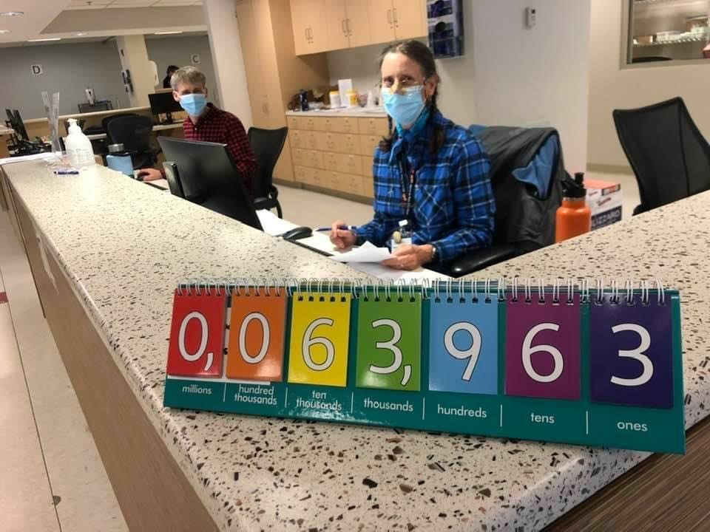
Efforts

Slide 14
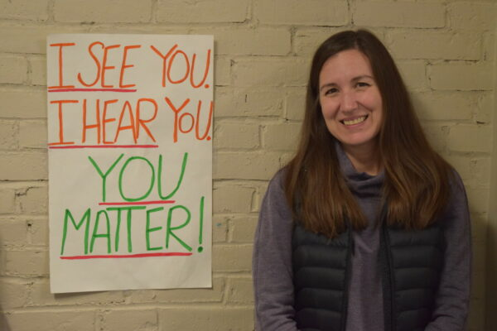
Mental Health/Adverse Childhood Experiences
To improve mental health outcomes of youth and adults, including a reduction in youth suicide and social isolation of older adults
Support: Midcoast Youth Center, Age Friendly Communities of the Lower Kennebec, Harpswell Aging at Home, People Plus, NAMI Maine, School Mental Health Committees, Bath Area YMCA, Seacoast United Maine, Housing Resources for Youth, Maine Coast Fisherman’s Association
Lead: Youth Mental Health Grants (Sources of Strength, Youth Mental Health First Aid, Social Emotional Health trainings), MOM (Maternal Opioid Misuse) Initiative, Center for Community Health & Wellness Classes/Events

Slide 15
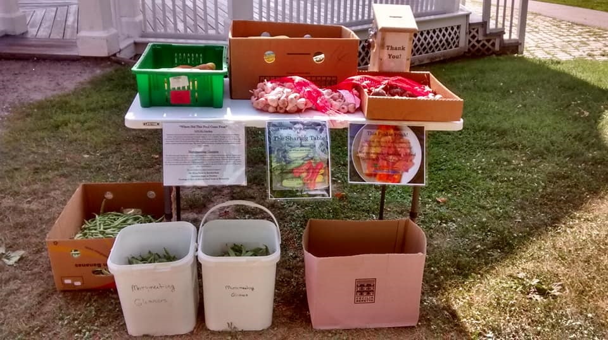
Social Determinants of Health
To improve the conditions in which people are born, grow, live, work and age and decrease health inequities
Support: Tedford Housing, Southern Midcoast Housing Collaborative, Midcoast Hunger Prevention, Merry Meeting Food Council, New Mainer/Immigrant partnerships, Oasis Free Health Clinics, United Way
Lead: Hunger Vital Signs, Aunt Bertha
“ Within the past 12 months we worried whether our food would run out before we got money to buy more.”
“ Within the past 12 months the food we bought just didn’t last and we didn’t have money to get more.”

Slide 16
Healthy Weight, Physical Activity & Healthy Eating
Support: School Wellness activities/policies, Let’s Go! Minigrant activities, Get Active Southern Midcoast! promotion of local resources
Lead: Let’s Go! School, Childcares, Providers; SNAP Nutrition Education classes

Slide 17
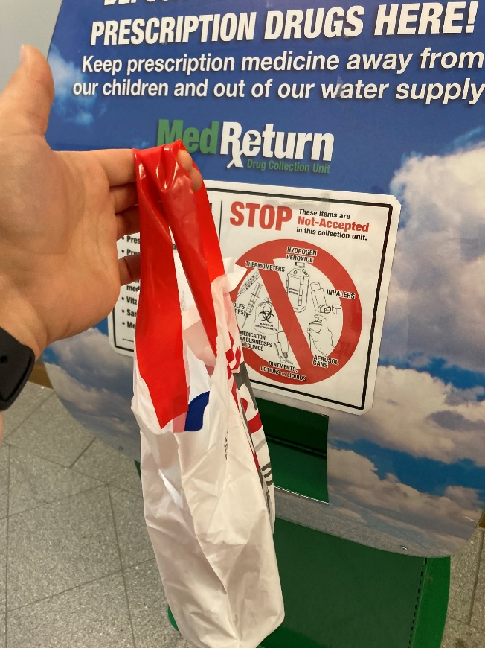
Substance use, including tobacco
To decrease rates of cancer, heart disease, substance use disorder and unintentional poisonings and increase quality of life
Support: Southern Midcoast Communities for Prevention, school vaping response, supported town & organization policies and ordinance efforts
Lead: Launched BeFree, Women’s Health and Behavioral Health tobacco treatment tailored support, launched MOM program, continued treatment programs, secured new prevention federal grant, vaping education & resources

Slide 18
How to Read the County Health Profiles and Health Equity Data Sheets
Notes:
JSI or other facilitator

Slide 19
How to Read County Health Profile
CHANGE shows statistically significant changes in the indicator over time, based on 95% confidence interval (see description on page 3).
ê | means the health issue or problem is getting better over time.
! | means the health issue or problem is getting worse over time.
○ | means the change was not statistically significant.
N/A | means there is not enough data to make a comparison.
BENCHMARK compares [COUNTY] data to state and national data, based on 95% confidence interval (see description on page 3).
ê | means [COUNTY] is doing significantly better than the state or national average.
! | means [COUNTY is doing significantly worse than the state or national average.
○ | means there is no statistically significant difference between the data points.
N/A | means there is not enough data to make a comparison.
ADDITIONAL SYMBOLS
* | means results may be statistically unreliable due to small numbers, use caution when interpreting.
— | means data is unavailable because of lack of data or suppressed data due to a small number of respondents.
EXAMPLE
Notes:
JSI or other facilitator
A star means that the health issue or problem is getting better over time or better in comparison to another place
A red exclamation point means that the health issue or problem is getting worse over time or worse in comparison to another place
A gray circle means that the dating hasn’t changed over time or isn’t much different in comparison to another place
N/A means that there was not enough data to be able to make a comparison
There are two additional symbols you might see:
A black dot means that you should use caution when interpreting the data – the results might be unreliable because of small numbers
A black dash means that data was unavailable, or that data was suppressed due to a small number of respondents
(Go to next slide and walk audience through an example)

Slide 20
How to Read County Health Profile
EXAMPLE
 | AROOSTOOK COUNTY |  |  | BENCHMARKS
INDICATOR | POINT 1 | POINT 2 | CHANGE | MAINE | +/- | U.S. | +/-
Individuals living in poverty | 2009-2011 15.6% | 2015-2019 16.1% | ¡ | 2015-2019 11.8% | ! | 2019 12.3% | N/A
Notes:
Here’s an example of how we’ve visualized the data in the County Health Profiles.
The charts in this presentation are all excerpts from the Data Health Profiles that were created by MaineHealth and the Maine CDC. They contain data pulled from publicly available sources that are designed to help people learn more about the health of their communities. Not all the data points are available for every measure, but we’ve included data wherever we can.
The green bars represent data from your community. The left most one represents a past data point, and the right bar represents the most recent data point available when the data was gathered. These are the same data points used in the Data Health Profiles.
The grey bars represent data for the state of Maine as a whole- on the left- and for the United States as a whole- on the right, when it is available.
We’ve also noted where differences in the data points are ‘statistically significant’. A difference between two measurements is significant when scientists can say, with a known degree of confidence, that the difference between them is large enough that the difference is most likely to be caused by an actual difference in the item being measured, and not caused by error associated taking the measurement. All of these tests are comparing the most recent data point for your community to other data points. A red exclamation mark indicates a difference that your community is significantly different in a less desirable direction compared to the data point with the symbol. A green star indicates that your community is significantly different in a more desirable direction. A grey circle indicates that there is no significant difference.
(keep in presentation – do not read for deaf/HOH event or people with disabilities). A difference between two measurements is significant when scientists can say, with a known degree of confidence, that the difference between them is large enough that the difference is most likely to be caused by an actual difference in the item being measured, and not caused by an error associated taking the measurement. All of these tests are comparing the most recent data point for your community to other data points.
For example, in this slide, we have two symbols. The grey circle next to the measurement for 2009-2011 Aroostook County means that there is no significantly different change in the rate of poverty in Aroostook County when comparing the data from 2009-2011 to the data from 2015-2019. The red exclamation mark next to the Maine data point says there is a significant difference between 2015-2019 Aroostook County and 2015-2019 Maine, and that it is less desirable that Aroostook County has a higher rate of individuals living in poverty. No comparison could be made to the data for the U.S. because the years of data collection were different.

Slide 21
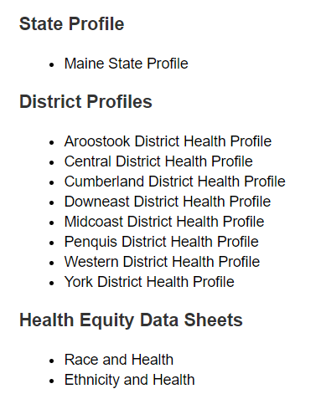
For More Data
www.mainechna.org
Notes:
The Maine Shared CHNA website contains health profiles for 3 of Maine’s largest cities, 16 counties, 5 public health districts, the state, as well as data provided by race, ethnicity, educational attainment, gender, sexual orientation, older adults, insurance status, income, and rurality.
IN addition, there is an interactive data portal where you can search by specific data points. All these breakdowns are then provided by data point.
REGARDING COVID-19 DATA
The Maine Shared CHNA data set does not include any data of COVID-19. This is largely due to the fact that there is a much more up-to-date and comprehensive Maine Data Dashboard continually being updated on the Maine CDC website.
Here you can find daily lab results, new case counts by date, trends, county breakdowns, data by race, and comparisons to other states and the nation.

Slide 22
Key Findings
Notes:
As we walk through the following data slides together, take notes. What surprises you? What stands out? What’s moving in the wrong direction?
Once the data presentation is over, you will be divided into breakout groups to discuss the data, share your top concerns, identify your top priorities, and share your knowledge about what’s working and what we need to work on to addres those top concerns.
Ready? Here we go.

Slide 23
Demographics
Age distribution for Sagadahoc County
AGE
SAGADAHOC COUNTY
POPULATION
35,452
STATE OF MAINE
POPULATION
1,362,359
Notes:
Sagadahoc County has the 5th smallest population of any Maine County after Lincoln, Washington, Franklin, and Piscataquis County. The population is aging. There are fewer children and young adults and more adults over the age of 65, and fewer adults of the age where they might expect to have children.
Source: US Census Bureau, American Community Survey

Slide 24
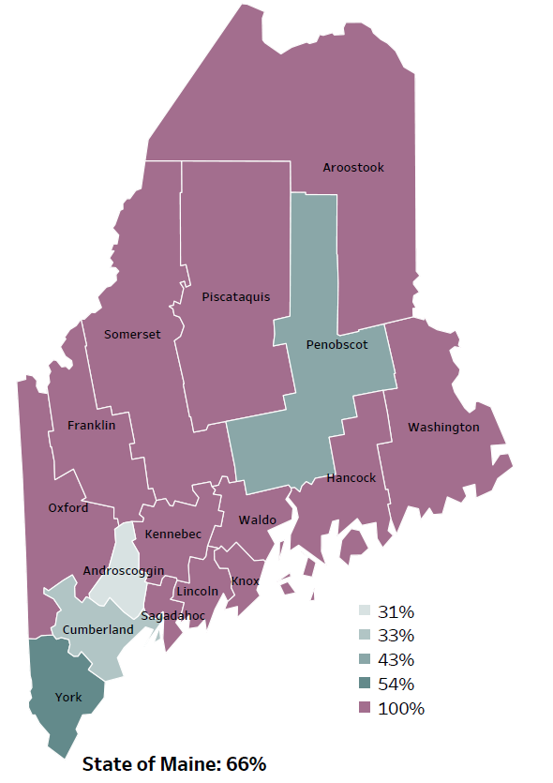
Social Determinants of Health
Percentage of people living in
rural areas
2019
New England Round Table for Rural Health
Notes:
Sagadahoc County is one of 12 counties with no population in an urban area. These data are based on the most recent Census estimates at the Zip-code level, and calculated use rural Urban Commuting Area codes. The categories were established by the New England Rural Health Association. This data is NOT comparable to 2010 US Census data on populations living in rural areas, as that data uses a different definition for rural.
Source: Data, Research and Vital Statistics town-level population file

Slide 25
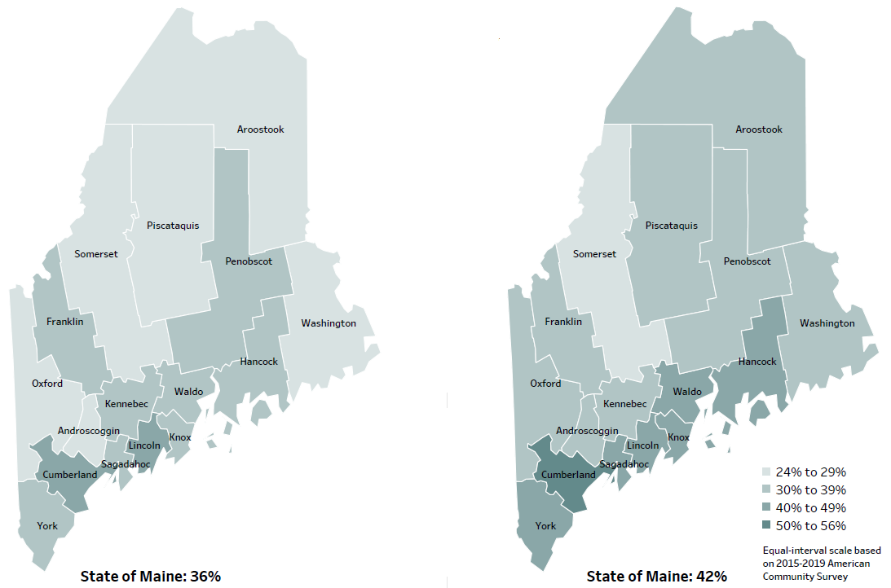
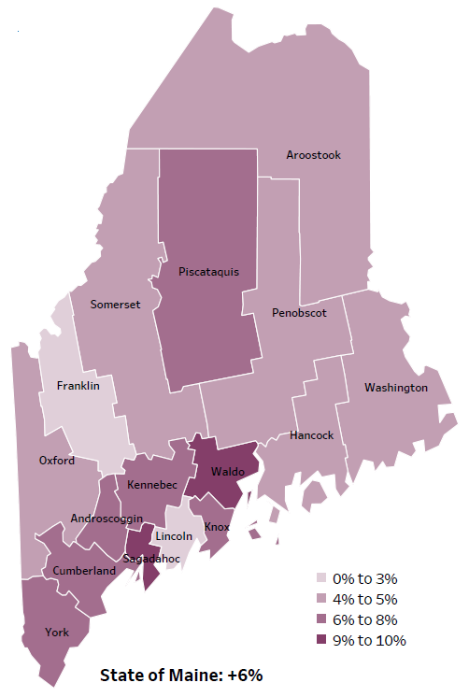
Social Determinants of Health
Percent of population over age 25 with an associate’s degree or higher
2010
American Community
Survey
Change in percent of population over age 25 with an associate’s degree or higher
2010 to 2015-2019
2015-2019
American Community
Survey
Notes:
These maps show the educational attainment of adults over 25 for two different time periods. Sagadahoc County has had an increase in the rate of adults who have achieved an associate’s degree or higher degree of education. This is highlighted in the change over time map, which shows that this was a greater increase than 14 out of the 16 counties.
Source: US Census Bureau, American Community Survey

Slide 26
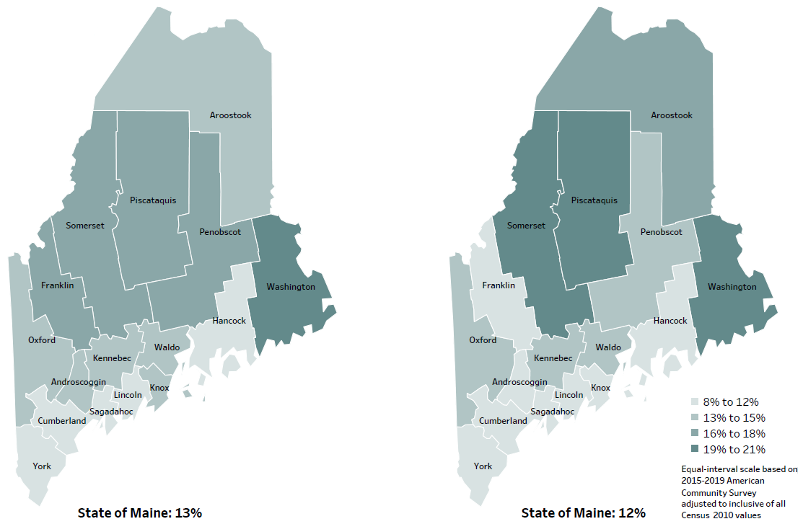
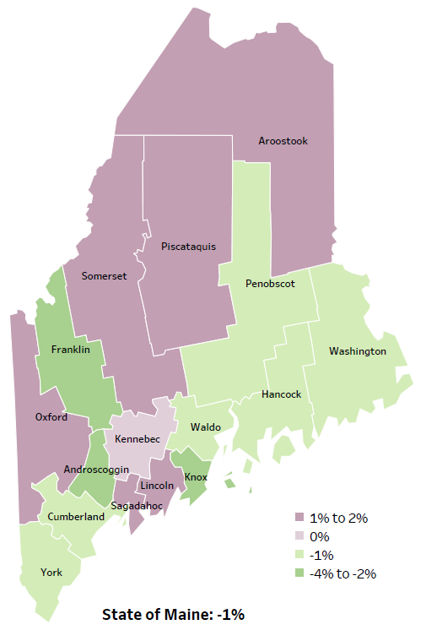
Social Determinants of Health
Percent of population in poverty
2010
American Community
Survey
Change in percent of population in poverty
2010 to 2015-2019
2015-2019
American Community
Survey
Notes:
These maps show the rate of poverty for two different time periods. Sagadahoc County’s poverty rate has slightly increased over the time period, as shown in the change over time map. Although the poverty rate has increased in Sagadahoc, it has one of the lowest poverty rates in the State. During this period, poverty decreased in Maine overall.
Source: US Census Bureau, American Community Survey

Slide 27
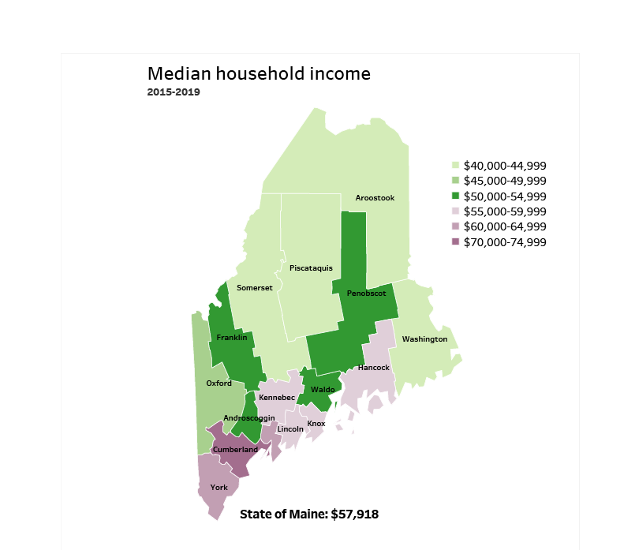
Social Determinants of Health
Notes:
Sagadahoc County has a median household income of $63,694. This is higher than 13 counties and equal to 1 other county. Sagadahoc has one of the highest median incomes comes in the state. This is likely due to the proximity of Maine’s largest and most economically active metro areas.
Source: American Community Survey

Slide 28
Social Determinants of Health
Notes:
This graph shows the rate of children living in poverty within Sagadahoc County. As you can see, poverty levels have decreased between 2018 and 2019. Although Sagadahoc’s rate is lower than the State’s the difference is not considered significant. Children living in poverty are more vulnerable to hunger, illness, insecurity, and instability. Numerous studies have shown that poverty increases parents’ stress and impairs parenting practices; and that poverty is linked to disruptions in parents’ mental health.
Source(s): US Census Bureau, Small Area Income and Poverty Estimates
Caldwell, L., J.D., PhD., (2014). Childhood Poverty, Living Below the Line. American Psychological Association. Retrieved from: https://www.apa.org/pi/ses/resources/indicator/2014/06/childhood-poverty
Read as needed- Definition: Percentage of children, ages 0-17 years, who live in households where the total income of the householder's family is below the established federal poverty level.

Slide 29
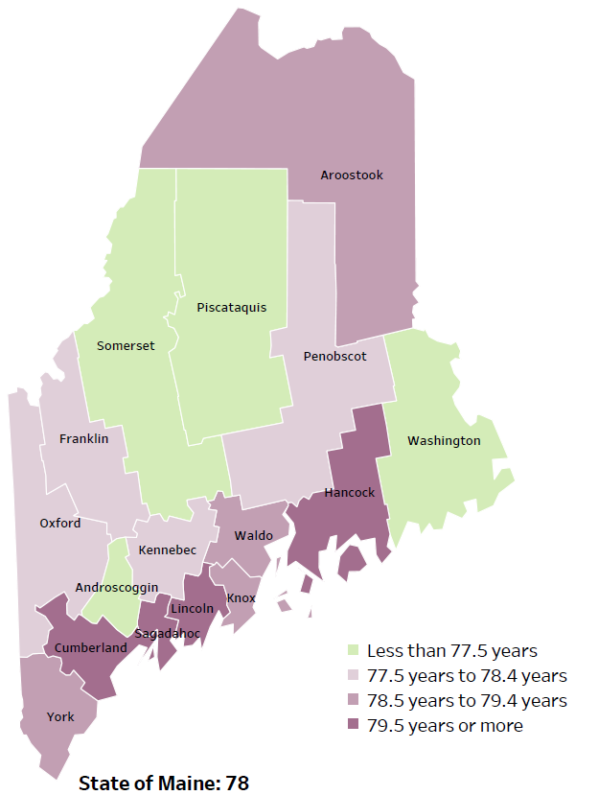
Mortality
Life Expectancy
2017-2019
National Center for Health Statistics,
CDC
RANK | MAINE | SAGADAHOC
1 | Cancer | Heart Disease
2 | Heart Disease | Cancer
3 | Unintentional Injury | Chronic Lower Respiratory Disease
4 | Chronic Lower Respiratory Disease | Stroke
5 | Stroke | Unintentional Injury
Notes:
The life expectancy in Sagadahoc County is 80, which is significantly higher than the state average of 78. Sagadahoc County has one of the highest life expectancies in the state. This is an indication that more people are dying at older ages than residents in many other counties in Maine.
The table on the right side of the slides shows the five leading causes of death in Sagadahoc County. They are also the leading causes of death for the whole state of Maine.
The leading cause of death in the County is Heart Disease, which is the 2nd leading cause in Maine, after Cancer. Cancer is the 2nd leading cause in Sagadahoc, following, Chronic Lower Respiratory Disease, Stroke, & Unintentional Injury.
Some highlights:
Similar to Sagadahoc’s leading causes of death in the U.S. include- Heart Disease, and cancer as the 2nd leading cause.
The 5th leading cause of death- Unintentional Injury- includes a number of accidental causes: Three of the most common causes are i) Deaths due to motor vehicle crashes, ii) deaths due to accidental falls, iii) deaths due to poisonings that either were unintentional, or the intent was undetermined. Some Firearm deaths may also be classified as unintentional. Suicides, some Firearm deaths and some Poisoning deaths are classified as intentional injury

Slide 30
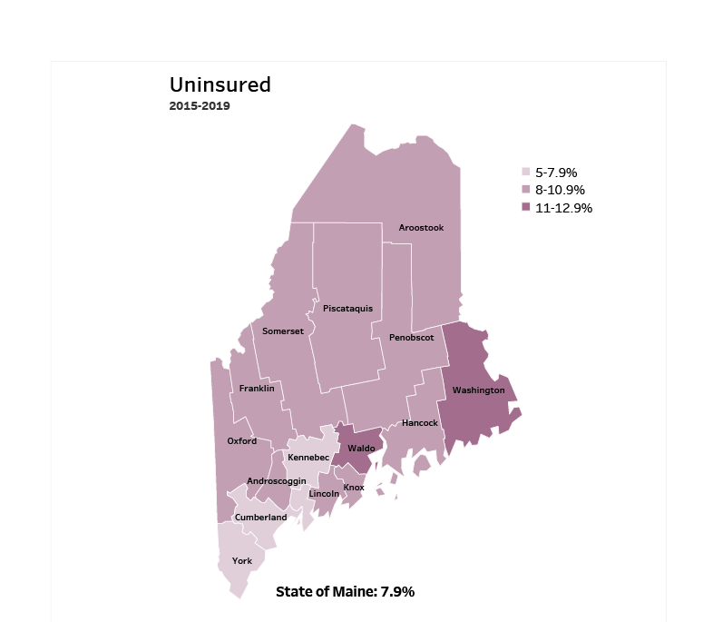
Access
Notes:
Sagadahoc County has an uninsured rate of 6.5%, which is higher than 1 other county and about equal to 3 counties. Lack of insurance can lead to delayed medical care, emergency room treatment and poorer health outcomes.
Source: American Community Survey
Read as needed- Definition: Percentage of people who do not currently have any form of health insurance (either individually purchased, provided through their employer, or provided through the government).

Slide 31
Cancer
Notes:
This slide shows the rate of women diagnosed with breast cancer in Sagadahoc County. The rate in Sagadahoc County is higher than both the State, and U.S., but the difference is not considered significant.
Source: Maine CDC Vital Records
Read as needed- Definition: Rate per 100,000 females of deaths from breast cancer.

Slide 32
Cancer
Notes:
Prostate cancer deaths have increased overtime within Sagadahoc County. The rate is significantly higher than Maine overall.
Data Source: Maine Cancer Registry
Read as needed- Definition: Rate per 100,000 males of deaths from prostate cancer.

Slide 33
Cancer
Notes:
Similar to the previous slide, the rate of those diagnosed with melanoma skin cancer in Sagadahoc is significantly higher than the State’s rate.
Data Source: Maine Cancer Registry
Read as needed- Definition: Rate per 100,000 people of new cases of melanoma of the skin.

Slide 34
Cardiovascular Disease
Notes:
Stroke deaths have decreased within Sagadahoc County over time, but not to a significant degree. The rate of death due to stroke is significantly higher in Sagadahoc than in Maine and the U.S., overall. We have calculated the rates so that they can be compared to other parts of the state that might have a population with a different mix of ages. Older people tend to have higher rates of many diseases and health conditions. It’s important to adjust for age so that we don’t accidentally mistake a place with older people for a place with an unusual number of disease-related deaths.
Data Source: Maine CDC Vital Records
Read as needed- Definition: Rate per 100,000 people of deaths with stroke as an underlying cause of death.

Slide 35
Cardiovascular Disease
Notes:
This graph compares both the County’s rate of stroke hospitalizations to the State of Maine’s rate. Residents in Sagadahoc are significantly more likely to be hospitalized for a stroke when compared to the state. A stroke can cause lasting brain damage, long-term disability, or even death. Signs of a stroke can range from mild weakness to paralysis or numbness on one side of the face or body. Other signs include a sudden and severe headache, sudden weakness, trouble seeing, and trouble speaking or understanding speech.
Source(s): Maine Health Data Organization Hospital Inpatient Database
NIH, U.S. National Library of Medicine, (2021). Retrieved from: https://medlineplus.gov/stroke.html
Read as needed- Definition: Rate per 10,000 people of hospital discharges with a principal diagnosis of stroke.
We have calculated the rates so that they can be compared to other parts of the state that might have a population with a different mix of ages. Older people tend to have higher rates of many diseases and health conditions. It’s important to adjust for age so that we don’t accidentally mistake a place with older people for a place with an unusual number of disease-related deaths.

Slide 36
Physical Activity, Nutrition, and Weight
Notes:
This graph shows the overall percentage of Sagadahoc residents who do not engage in physical activity outside of work. A sedentary lifestyle has a harmful effect on health. There has been a significant increase between 2016 & 2017 of County residence who do not engage in additional physical activity outside of work. Although Sagadahoc’s rate of inactivity is higher than Maine and the U.S, the difference would not be considered significant.
Data Source(s): Behavioral Risk Factor Surveillance System
Park, J. H., Moon, J. H., Kim, H. J., Kong, M. H., & Oh, Y. H. (2020). Sedentary Lifestyle: Overview of Updated Evidence of Potential Health Risks. Korean journal of family medicine, 41(6), 365–373. https://doi.org/10.4082/kjfm.20.0165
Read as needed- Definition: Percentage of adults who did not participate in any physical activities or exercises during the past month, other than during their regular job.

Slide 37
Pregnancy and Birth Outcomes
Notes:
This graph shows the percentage of mother’s who attended more than 80% of their prenatal visits within Sagadahoc County. The County’s percentage has slightly decreased since 2016-2019. Sagadahoc’s rate is significantly less compared to the State overall.
Source: Maine CDC Vital Records
Read as needed- Definition: Percentage of new mothers who had more than 80% of the expected prenatal visits.

Slide 38
Environmental Health
Notes:
Toddlers under 2-years-old in Sagadahoc County are being tested for lead exposure at a significantly lower rate than the state. The testing rates have improved significantly between 2018 & 2019. Although there has been an increase within the county since 2018, this should be a focus area given No lead exposure in young children is considered safe, as it can have cognitive and health impacts.
Data Source: Maine CDC Childhood Lead Poisoning Prevention Unit
Read as needed- Definition: Percentage of children, ages 12-23 months, who have had their blood tested for elevated blood lead levels.

Slide 39
Environmental Health
Notes:
Similar to the previous slide, 2-year-olds in Sagadahoc County are being tested for lead exposure at a significantly lower rate than the state.
Data Source: Maine CDC Childhood Lead Poisoning Prevention Unit
Read as needed- Definition: Percentage of children, ages 24-35 months, who have had their blood tested for elevated blood lead levels.

Slide 40
Unintentional Injury
Notes:
Injury-related deaths is the 5th leading cause of death in Sagadahoc County. The rate has risen significantly over the years in Sagadahoc but remains less than Maine and the U.S. overall.
Data Source: Maine CDC Vital Records
Read as needed- Definition: Rate per 100,000 people of deaths due to injuries.
Age Adjustment: We have calculated the rates so that they can be compared to other parts of the state that might have a population with a different mix of ages. Older people tend to have higher rates of many diseases and health conditions. It’s important to adjust for age so that we don’t accidentally mistake a place with older people for a place with an unusual number of disease-related deaths.

Slide 41
Unintentional Injury
Notes:
This indicator shows the rate of emergency department hospitalizations due to traumatic brain injury. Sagadahoc County’s is significantly higher than the State’s.
Source: Maine Health Data Organization Hospital Inpatient and Outpatient Databases
Read as needed- Definition: Rate per 10,000 people of emergency department discharges with a diagnoses of traumatic brain injury.
Age Adjusted (Read as needed): We have calculated the rates so that they can be compared to other parts of the state that might have a population with a different mix of ages. Older people tend to have higher rates of many diseases and health conditions. It’s important to adjust for age so that we don’t accidentally mistake a place with older people for a place with an unusual number of disease-related deaths.

Slide 42
Intentional Injury
Notes:
This chart shows the rate of firearm deaths, due to either homicide, suicide, or by accident within Sagadahoc County. Sagadahoc’s rate has increased significantly since 2011 and is much higher than the State’s and U.S.’s overall.
Source: Maine CDC Vital Records
Read as needed- Definition: Rate per 100,000 people of deaths due to firearms, all intents.
Age Adjusted (Read as needed): We have calculated the rates so that they can be compared to other parts of the state that might have a population with a different mix of ages. Older people tend to have higher rates of many diseases and health conditions. It’s important to adjust for age so that we don’t accidentally mistake a place with older people for a place with an unusual number of disease-related deaths.

Slide 43
Intentional Injury
Notes:
The rate of suicide deaths has increased over time in Sagadahoc County and are higher than Maine as a whole. None of these differences are significantly different.
Source: Maine CDC Vital Records
Read as needed- Definition: Rate per 100,000 people of deaths due to suicide.
Read as needed (Age Adjustment)- Definition: We have calculated the rates so that they can be compared to other parts of the state that might have a population with a different mix of ages. Older people tend to have higher rates of many diseases and health conditions. It’s important to adjust for age so that we don’t accidentally mistake a place with older people for a place with an unusual number of disease-related deaths.

Slide 44
Intentional Injury
Notes:
This graph shows the percentage of Sagadahoc high school students who engage in intentional self-injury. Intentional self-Injury is defined as a deliberate, self-inflicted damage of body tissue without suicidal intent. Methods of self-injury include cutting, burning, scratching, and banging or hitting, and most people who self-injure have used multiple methods. The County’s percentage has increased since 2017 and is now significantly higher than the State’s overall.
Source: Maine Integrated Youth Health Survey
Klonsky, E. D., Victor, S. E., & Saffer, B. Y. (2014). Nonsuicidal self-injury: what we know, and what we need to know. Canadian journal of psychiatry. Revue canadienne de psychiatrie, 59(11), 565–568. https://doi.org/10.1177/070674371405901101
Read as needed- Definition: Percentage of high school students who have ever done something to purposely hurt themselves without wanting to die, such as cutting or burning themselves on purpose. Data collected in odd numbered years.

Slide 45
Intentional Injury
Notes:
Similar to the previous slide, this graph shows the percentage of middle school students within the County who engage in self injurious behavior. There has been an increase between 2017 & 2019. The County’s rate is higher than the State’s.
Source: Maine Integrated Youth Health Survey
Read as needed- Definition: Percentage of seventh- and eighth-grade students who have ever done something to purposely hurt themselves without wanting to die, such as cutting or burning themselves on purpose. Data collected in odd numbered years.

Slide 46
Intentional Injury
Notes:
This chart shows the rate of Sagadahoc County’s High School students who reported being bullied on school property. There’s been an increase since 2017, the County’s rate is significantly higher than the State’s overall rate.
Data Source: Maine Integrated Youth Health Survey
Read as needed - Definition: Percentage of seventh- and eighth-grade students who have ever been bullied on school property. Data collected in odd numbered years.

Slide 47
Mental Health
Notes:
The rate of Sagadahoc County residents being treated in the emergency room for a mental health condition is significantly higher than the state rate. This could be related to a lack of access to mental health professionals in the area.
Data Source: Maine Health Data Organization Hospital Inpatient and Outpatient Databases
To be read as needed. Definition: Rate per 10,000 people of emergency department discharges with a principal diagnosis of mental health condition.
We have calculated the rates so that they can be compared to other parts of the state that might have a population with a different mix of ages. Older people tend to have higher rates of many diseases and health conditions. It’s important to adjust for age so that we don’t accidentally mistake a place with older people for a place with an unusual number of disease-related deaths.

Slide 48
Substance Use
Notes:
This slide shows the rate of binge drinking among Sagadahoc High School students. The percentage has decreased significantly since 2015. There is a significant difference between Sagadahoc and Maine High Schoolers overall.
Data Source: Maine Integrated Youth Health Survey
To be read as needed. Definition: Percentage of high school students who had five or more alcoholic drinks on at least one day in the last 30 days. Data collected in odd numbered years.

Slide 49
Tobacco Use
Notes:
This slide shows the percentage of Sagadahoc County high school students who have used an e-cigarette at least once in the last 30 days. Data is collected in odd numbered years and, as you can see, use has increased between 2017 & 2019. This increase is significant.
Data Source: Maine Integrated Youth Health Survey
To be read as needed. Definition: Percentage of high school students who used an electronic vapor product at least one day in the last 30 days. Data collected in odd numbered years.

Slide 50
Tobacco Use
Notes:
This chart shows the percentage of middle school students in Sagadahoc County who have smoked an e-cigarette within the past 30 days. The rate has increased significantly since 2017. The overall percentage between the County and Maine middle schoolers overall are similar.
Source: Maine Integrated Youth Health Survey
Read as needed- Definition: Percentage of seventh- and eighth-grade students who used an electronic vapor product at least one day in the last 30 days. Data collected in odd numbered years.

Slide 51
Breakout Discussions

Slide 52
Reconvene

Slide 53
Wrap up and Next Steps

Slide 54
Contacts
Local Contact(s):
Drexell White, Midcoast Public Health District Liaison, MeCDC, White, Drexell R Drexell.R.White@maine.gov
Melissa Fochesato, Director, Community Health Promotion, mfochesato@midcoasthealth.com
Jo Morrissey, Program Manager, Maine Shared Community Health Needs Assessment, info@mainechna.org, www.mainechna.org.

